Slide 1
Process-Algebraic Models of Multi-Writer
Multi-Reader Non-Atomic Registers, and Adding Liveness Properties
Myrthe Spronck
YR-CONCUR, 23 September 2023

Slide 2
The mutual exclusion problem
N threads access a shared resource in their critical sections, access may not happen simultaneously
Problem originally defined for atomic registers
Lamport argues assuming atomic registers does not solve the true problem
Algorithms exist for mutex with non-atomic registers, they are difficult to analyse
Our project: model check mutex algorithms with non-atomic registers
We model the registers separately from the algorithms
Lamport presents two types of non-atomic registers: safe and regular
Original presentations are single-writer, we model multi-writer versions
Recap CONCUR Talk

Slide 3
Single-writer safe registers: a read not concurrent with a write returns the most recently written value
Values returned by reads concurrent with the same write are independent
read ?
read 0/1/2
read 0
read 0/1/2
read ?
write 0
write 2
Safe Registers

Slide 4
Single-writer safe registers: a read not concurrent with a write returns the most recently written value
Multi-writer variant based on Raynal
In our models: stabilises to single value
 | Not concurrent with write | Concurrent with write
Read | Return last written value | Return arbitrary value in domain
Write | Set intended value | Set arbitrary value in domain
write 1
read 0/1/2
read 0/1/2
write 0
Safe Registers

Slide 5
Modelling, informally
Operations split between start and finish actions
Register tracks current value d
Additionally tracks for each thread if there was a concurrent write during the current operation
 | Not concurrent with write | Concurrent with write
Read | Return last written value | Return arbitrary value in domain
Write | Set intended value | Set arbitrary value in domain
sr₀
fr₀(0)
d := ?
read 0
read 2
read 1
write 1
read 2
T0:
write 0
write 2
write 0
T1:
d := 0
sw₁(2)
fw₁
+ d := 2
d := 2
Safe Registers

Slide 6
Single-writer regular register: a read returns either the last written value, or the value of a concurrent write
Possible to first read new value, then old
read 0/2
read ?
read ?
read 0
read 0/2
write 0
write 2
Regular Registers

Slide 7
Single-writer regular register: a read returns either the last written value, or the value of a concurrent write
Our multi-writer regular registers, informally
Concurrent writes behave as though they occurred in some order
A read returns either the value of a concurrent write, or the last-written value according to this ordering
read 1/2
write 1
read 2
read 0
read ?
write 0
write 2
Regular Registers

Slide 8
Modelling, informally
Operations split between start and finish actions
order write actions to generate ordering on-the-fly
Register tracks current value d, updated on order
Additionally tracks for active reads which values can be returned
d := 1
sr₀
fr₀(0)
{0, 2}
{2}
{1}
read 0
read 2
read 2
write 1
read 1
T0:
write 0
{0}
write 2
write 0
T1:
d := 0
sw₁(2)
ow₁
+ d := 2
fw₁
d := 0
Regular Registers

Slide 9
Single-writer atomic register: reads and writes behave as though they occurred in some order, reads return the last written value
read 2
read ?
read 0
read 0
read 0
read ?
read 2
write 0
write 2
Atomic Registers

Slide 10
Single-writer atomic register: reads and writes behave as though they occurred in some order, reads return the last written value
Same definition works for multi-writer registers
read 0
write 1
read 1
read ?
read 2
write 0
write 2
Atomic Registers

Slide 11
Modelling, informally
Operations split between start and finish actions
execute actions to generate linearisation on-the-fly
Register tracks current value d, updated on exec write
Save current value on exec read, return on finish read
d = 0
d = 2
d := 1
d = 1
sr₀
fr₀(0)
read 0
read 0
read 2
write 1
read 1
T0:
write 0
er₀
+ d = 0
write 2
write 0
T1:
d := 0
sw₁(2)
ew₁
+ d := 2
fw₁
d := 0
Atomic Registers

Slide 12
Verifying mutual exclusion algorithms
Properties:
Mutex: no two threads can simultaneously enter their critical sections
Reach: if a thread wants access to its critical section, then until it gets access it is always possible for it to eventually get access
Both are safety properties
Work so Far

Slide 13
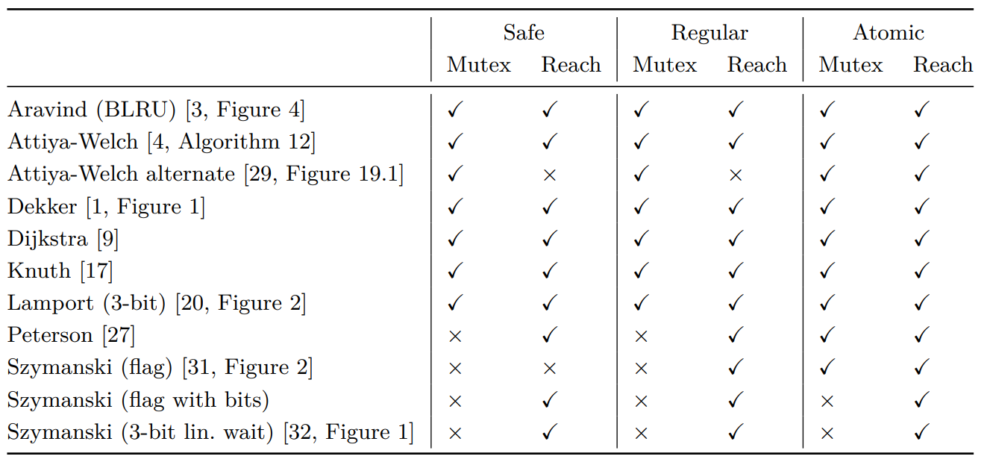
Work so Far

Slide 14
Liveness is extremely important for mutual exclusion algorithms
Without liveness, solving mutex is trivial
Starvation freedom: if a thread wants access to the critical section, it eventually obtains it
Verifying liveness properties proved difficult
Hence, Reach: a very, very weak version of starvation freedom
Adding Liveness

Slide 15
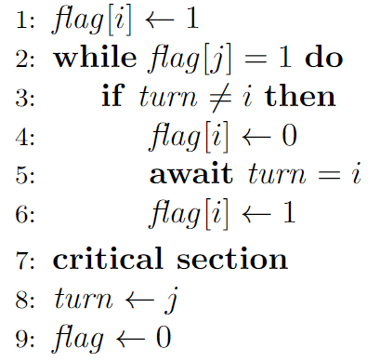
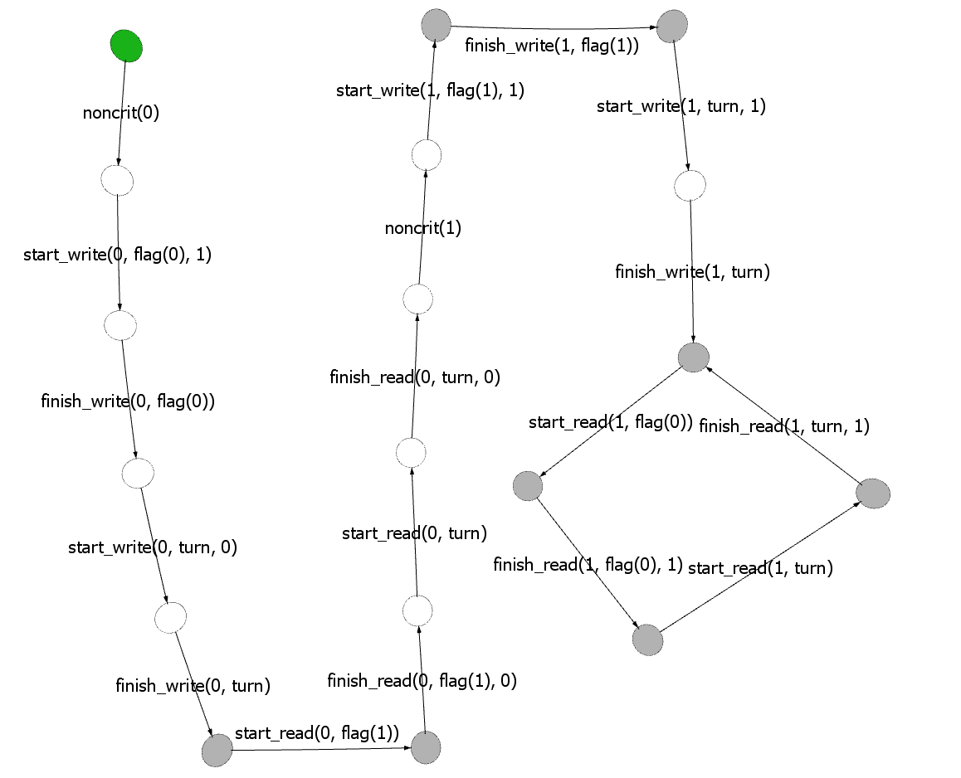
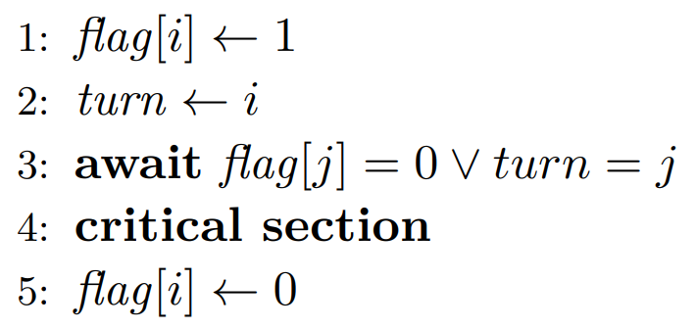
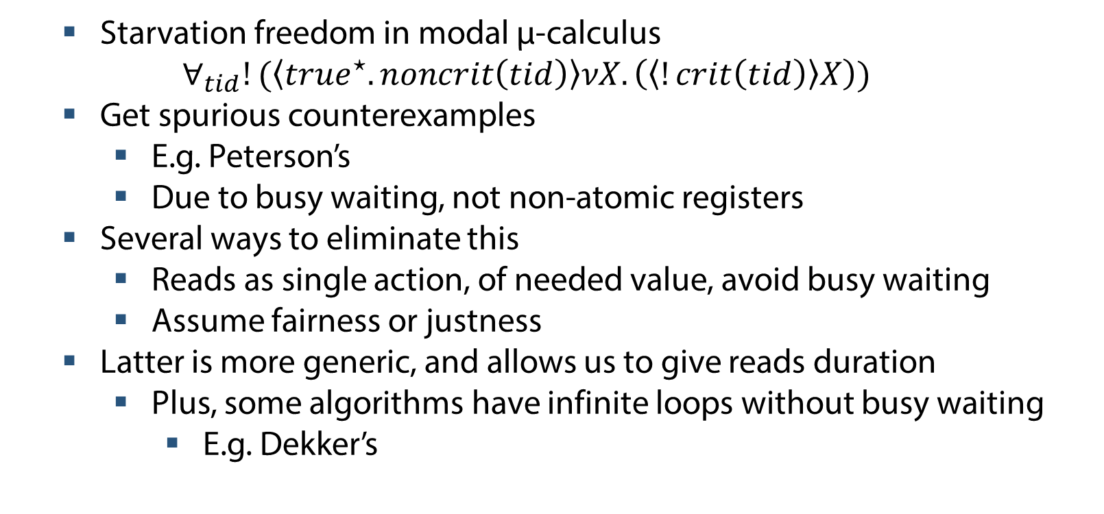
Starvation freedom in modal μ-calculus
$$∀_{tid}!(\left\langle {true}^{⋆}.noncrit\left(tid\right)\right\rangle νX.\left(\left\langle !crit\left(tid\right)\right\rangle X\right))$$
Get spurious counterexamples
E.g. Peterson’s
Due to busy waiting, not non-atomic registers
Several ways to eliminate this
Reads as single action, of needed value, avoid busy waiting
Assume fairness or justness
Latter is more generic, and allows us to give reads duration
Plus, some algorithms have infinite loops without busy waiting
E.g. Dekker’s
ω
noncrit
flag[0] ← 1
turn ← 0
flag[1] = 0
turn = 0
crit?
T0:
T1:
noncrit
flag[1] ← 1
turn ← 1
flag[0] = 1
turn = 1
Adding Liveness

Slide 16
Fairness assumptions label some infinite paths as unfair
Unfair paths are ignored
General shape: if something is possible often enough, it must take place often enough
Some examples: weak fairness of actions, strong fairness of actions, fair reachability of actions
Discuss these three in more detail
Fairness

Slide 17
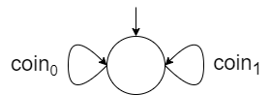
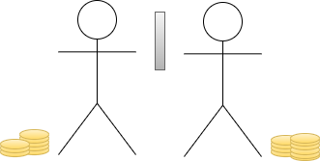
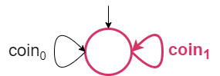
Weak fairness of actions: an action that is perpetually enabled from some point onward must occur infinitely often
Perpetually enabled: enabled in every state
Fairness

Slide 18
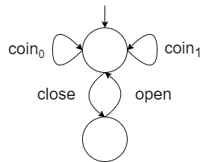
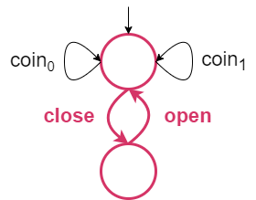

Weak fairness of actions: an action that is perpetually enabled from some point onward must occur infinitely often
Perpetually enabled: enabled in every state
Fairness

Slide 19
Strong fairness of actions: an action that is relentlessly enabled must occur infinitely often
Relentlessly enabled: enabled infinitely often
Fairness

Slide 20
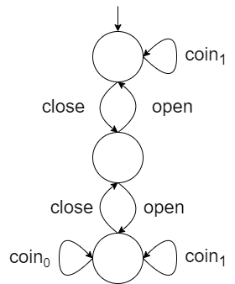
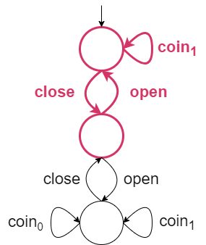
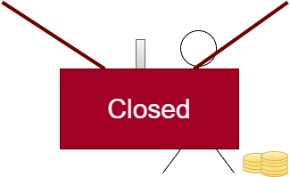
Strong fairness of actions: an action that is relentlessly enabled must occur infinitely often
Relentlessly enabled: enabled infinitely often
Fairness

Slide 21
Fair reachability of actions: an action that is perpetually reachable must occur infinitely often
Also known as hyperfairness or ∞-fairness
Fairness

Slide 22
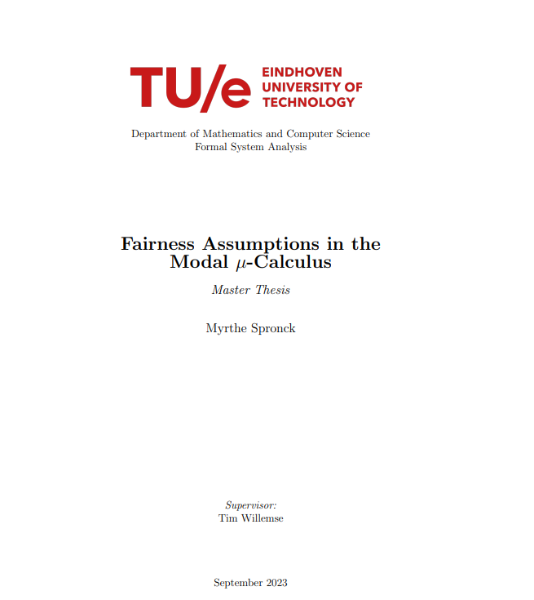
Why discuss these three?
Weak and strong fairness are very common
Reach is starvation freedom under fair reachability of actions
In my Master’s thesis, designed modal μ-calculus formulae for starvation freedom under these three assumptions
Also covered other properties
Also discussed fairness applied to other aspects, e.g. components
Included (written) proofs
Can use these formulae in future verifications
Add blocking actions: do not force noncrit to occur
Fairness

Slide 23
Why multiple fairness assumptions?
Discover the weakest assumption under which an algorithm is correct
Fair reachability
Strong fairness
Weak fairness
Fairness

Slide 24
Fairness often not justified
Just because you try infinitely often does not mean you’ll succeed
Need a weaker assumption
Justness: once a transition is enabled that stems from a set of parallel components, one (or more) of these components eventually partake in a transition.
R.J. van Glabbeek, P. Höfner: Progress, justness, and fairness.
Definition on transitions, we interpret it on actions instead
We use the interpretation from M. Bouwman, B. Luttik, T.A.C. Willemse: Off-the-shelf automated analysis of liveness properties for just paths.
Fair reachability
Strong fairness
Weak fairness
Justness
Justness

Slide 25
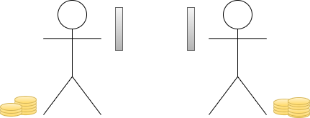
Idea of justness: if a component can take an action, it will do so unless interfered with
Distinguish between reasonable and unreasonable interference
Goes further than action labels
vs.
Justness

Slide 26
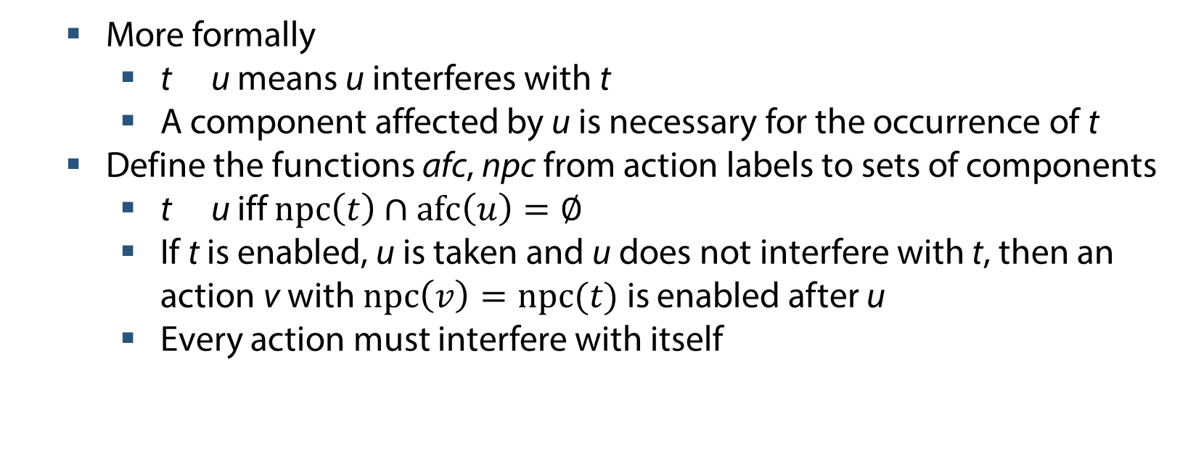
More formally
t u means u interferes with t
A component affected by u is necessary for the occurrence of t
Define the functions afc, npc from action labels to sets of components
t u iff $npc\left(t\right)∩afc\left(u\right)=∅$
If t is enabled, u is taken and u does not interfere with t, then an action v with $npc\left(v\right)=npc(t)$ is enabled after u
Every action must interfere with itself
Justness

Slide 27
Bouwman et al. present a formula for starvation freedom under justness
How to define afc and npc for register operations?
Threads are necessary for and affected by reading and writing
More difficult for registers themselves
Default: 1111
Reads and writes on the same register interfere
This may be undesirable
Registers in… | npc(read)? | afc(read)? | npc(write)? | afc(write)?
 | 0/1 | 0/1 | 0/1 | 0/1
Justness

Slide 28
Registers in… | npc(read)? | afc(read)? | npc(write)? | afc(write)?
 | 0/1 | 0/1 | 0/1 | 0/1
Bouman et al. use 1011 to model that reads are signals, that do not interfere with other actions
Reads cannot block writes
Writes can still block reads or other writes
Intuitively: in the case of non-atomic registers, surely nothing can prevent an operation from taking place?
If this interpretation is incorrect for non-atomic registers, what interpretation is correct?
Ongoing discussions with Rob van Glabbeek and Bas Luttik
Justness

Slide 29
Registers in… | npc(read)? | afc(read)? | npc(write)? | afc(write)?
 | 0/1 | 0/1 | 0/1 | 0/1
Seems it is more important how we model reads
In our models:
start_read action is enabled and taken
finish_read(x) is enabled for any value x that can be read from the register, updated in every state until a finish_read occurs
A common alternative:
If the algorithm requires the value v to be read, only read(v) can be enabled
If v cannot currently be read from the register, no read action is enabled
Discussion applies for safe, regular and atomic
Illustrate with atomic
Justness

Slide 30
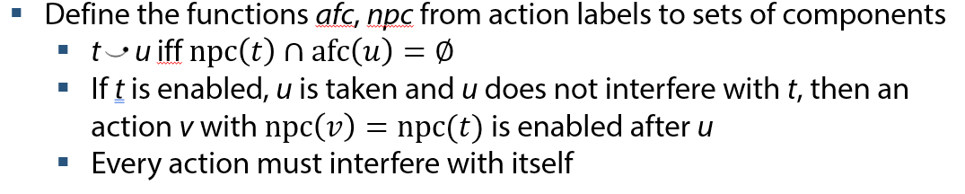
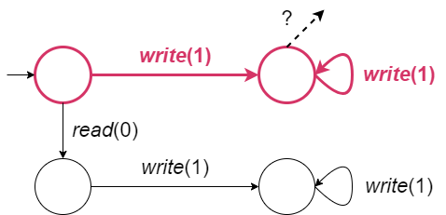
Registers in… | npc(read)? | afc(read)? | npc(write)? | afc(write)?
 | 0/1 | 0/1 | 0/1 | 0/1
Consider, with atomic registers
Register x initialised at 0
T0 awaits x = 0
T1 perpetually writes x := 1
It is only reasonable that the path where T0 never observes x = 0 is just
Only willing to read(0) on an atomic register:
If writes do not interfere with reads, this path is unjust
Register must be in a necessary state for read
Justness

Slide 31
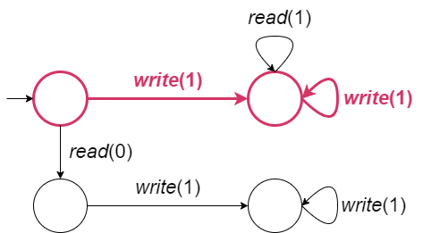
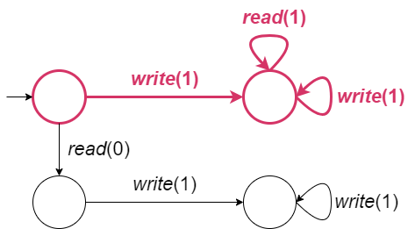
Registers in… | npc(read)? | afc(read)? | npc(write)? | afc(write)?
 | 0/1 | 0/1 | 0/1 | 0/1
Consider, with atomic registers
Register x initialised at 0
T0 awaits x = 0
T1 perpetually writes x := 1
It is only reasonable that the path where T0 never observes x = 0 is just
Willing to read either 0 or 1 (busy waiting)
This path being unjust seems reasonable (at the very least if non-atomic)
A different just path where x = 0 is never observed exists
Register state is not necessary for read
Justness

Slide 32
Registers in… | npc(read)? | afc(read)? | npc(write)? | afc(write)?
 | 0/1 | 0/1 | 0/1 | 0/1
Conclusions regarding safe registers (so far):
1001 seems reasonable for reading specific values,
0001 for reading arbitrary values (e.g. busy waiting)
We have done some analysis with 0001 for our models, further considerations are necessary
What about atomic and regular registers in our model?
How does this fit into the theory of justness?
Justness

Slide 33
A second problem with justness:
how to fill in afc and npc for the internal register actions?
order write (regular), exec write and exec read (atomic)
Must interfere with themselves
Must be necessary for and affected by same component
Unreasonable for threads to play a role here
But if registers in npc and afc, there are consequences
Regular registers: writes interfere with each other due to order write, this is undesirable
Atomic registers: all operations interfere with each other due to exec read and exec write, reads interfere with writes again
Seem to be stuck…
Justness

Slide 34
Possible solutions:
Cheat, explicitly state every action interferes with itself regardless of afc and npc definitions
Do include threads as components, since these actions are part of read/write operations
Something else?
Currently doing 1., further considerations necessary
Justness

Slide 35
Minor work still needed on fairness formulae
Significant work still needed on justness
formula exists but the npc and afc definitions require more rigorous considerations
Then, analyse liveness for mutex algorithms with non-atomic registers
Example: Dekker’s satisfies Reach, but not starvation freedom under any of our assumptions with non-atomic registers
(if accounting for blocking actions)
Buhr, Dice and Hesselink make the same observation, and propose a fixed version in Dekker’s mutual exclusion algorithm made RW-safe
We should model check this, of course ☺
Final Thoughts

